Slide 1
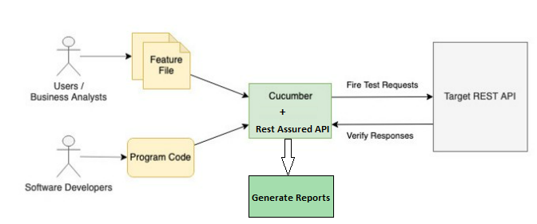
REST API Automation
High Level Flow:

